Slide 1
There’s No Place Like Econ and FinLit for the Holidays
with Alyse Pflanz
and Derek D’Angelo

Slide 2
Alyse Pflanz
Director
UNK Center of Economic Education
Born and raised in Nebraska, I was a 7-12 BMIT teacher for four years → turned college instructor. I just finished my 3rd year at UNK advising and teaching pre-service business education and business administration students, along with running the center. I am also working on my PhD in Educational Studies at UNL.

Slide 3
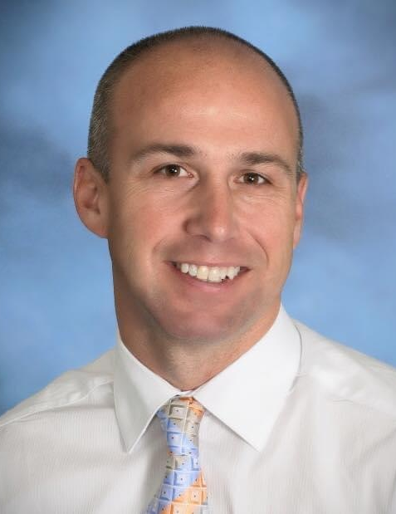
Derek D’Angelo
President
Michigan Council on Economic Education
Derek is an economics teacher with 24 years of experience in Michigan. He was the 2018 Excellence in Financial Literacy Education (EIFLE) National Educator of the Year. Currently, he is serving as President of the National Association of Economic Educators.

Slide 4
What to Expect in this Session
Provide a collection of resources that can be used around the holidays to supplement instruction
Create a vibrant classroom culture that looks for the economics and finlit in everything!
Demonstrate two of the lessons that will be available in the collection

Slide 5
Really, It’s Everywhere!

Slide 6
Let’s Play a Game!

Slide 7
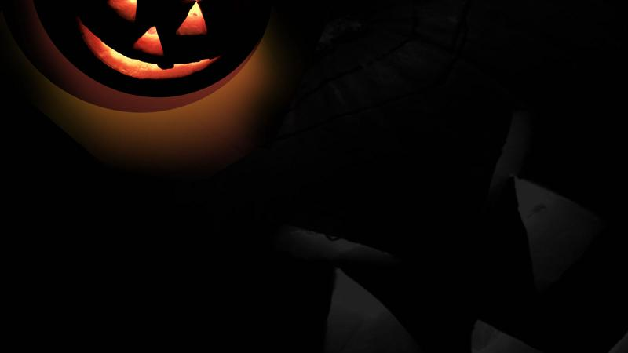
We are going to play this like an old game show called Card Sharks. One person will provide an answer and the other individuals in the session will guess higher or lower. If you guess correct you receive a point! If you guess incorrect you receive zero points. You will have a chance to double your points at the end of the game.

Slide 8
Source: NRF's Annual Halloween Spending Survey, conducted by Prosper Insights & Analytics
The survey asked 7,644 consumers about Halloween shopping plans. It was conducted September 1-9, 2020 and has a margin of error of plus or minus 1.1 percentage points.

Slide 9
1.
148 million
How many million Americans plan to celebrate Halloween this year?

Slide 10
2.
62%
What percent will hand out candy?

Slide 11
3.
32%
What percent of consumers will go to a specialty Halloween or costume store?

Slide 12
4.
15%
What percent will visit a haunted house?

Slide 13
5.
18%
Of celebrants, what percent will dress their pet in costume?

Slide 14
6.
22%
What percent will attend a Halloween party?

Slide 15
7.
$92.12
What is the average planned Halloween spending per celebrating household?

Slide 16
8.
42%
What percent of women will begin shopping for Halloween prior to October 1?

Slide 17
9.
53%
Of celebrants, what percent will decorate their home or yard?

Slide 18
10.
$29.90
What is the average planned Halloween spending per person on a costume?

Slide 19
11.
88%
Of celebrants aged 25-34, what percent plan to purchase a costume?

Slide 20
12.
40%
Of celebrants, what percent plan to purchase a greeting card?

Slide 21
What is your willingness to bear risk?
Your score right now will turn into extra credit points. You can turn in your sheet right now and receive extra credit OR you may risk them playing Card Sharks. If you can make it through all the cards without getting any wrong, I will double your extra credit. If you get one wrong, you will lose all your extra credit. Students who are playing should stand if they think the next card will be higher and sit on the floor if they think it is lower. Students in their chairs are either not playing or have been eliminated by getting a guess wrong. I will demonstrate and then you make your decision….

Slide 22
It’s time to play Card Sharks!

Slide 23
Data Source: Curriculum Connections:
https://nrf.com/media-center/press-releases/consumers-anticipate-new-ways-celebrate-halloween-despite-covid-19
Markets
Shifts in demand
Elasticity of supply
Personal Finance
Estimation
Risk

Slide 24
Black Friday… The Price is Right
Place students in groups and give them white boards.
Students are given about 30 seconds to come up with what they believe the price is of the item shown.
Closest team without going over gets the points.
If there are ties, all those who tied get the points.
You can make your own rules and include your own images based on what stores are relative to your students in your area/region
Presentation Link

Slide 25
Supporting Materials
Google Drive folder
Holiday Resources Spreadsheet organized by holiday
Any supplemental material not available online

Slide 26
Wrap Up and Q & A

Slide 27
CONNECT WITH US!

